Slide 1

MOVIE
RECOMMENDATION SYSTEM
MSCA 31009 Machine Learning Final Project
Allen Dong | Jack Du | Kenneth Jin | Renyuan Liu

Slide 2
AGENDA
Executive Summary
Problem Statement & Research Objective
EDA
Data Preparation & Feature Engineering
Hardware & Software Tools
Models
Singular Value Decomposition Collaborative Filtering Recommendation System
Neural Network Collaborative Filtering Recommendation System
Content Based Movie Recommendation System
Hybrid Recommendation System: Content + Collaborative
Findings & Conclusion
Lessons Learnt & Future Recommendation

Slide 3

Executive Summary
This project aims to build a movie recommendation system through a filtering process that is based on user preferences and ratings on their browsing history. It takes information from both users and movies as inputs and then implements the machine learning algorithms such as collaborative filtering, content-based filtering, and a hybrid model to create personalized movie recommendations. The dataset we used here consists 670+ unique user and 9000+ movie information sourcing from the MovieLens & IMDB website.

Slide 4
Problem Statement & Research Objective
With online streaming sites competing for user's attention, a feature that comes in handy in attracting customers and ensuring repeat business is content recommendation. In this project, given a set of users and their previous ratings on movies and movies general information, we provide a mechanism to optimize user's streaming experience.
Increase Customer Engagement
01
Achieve customer loyalty by providing relevant content and maximizing the time spent on the channel.
Drive Traffic
02
For movie distribution channels, our recommendation system potentially increases website traffic by sending out customized email notifications with targeted blasts.
Boost Revenues
03
The recommendation system can significantly boost CTRs, conversions, and other important metrics which lead to generating more profits.

Slide 5
Data Summary
 | Description | Data size | Row Numbers | Data Source
Ratings | Movies’ rating by users | 2.44 MB | 440,016 | MovieLens-100K from Kaggle
Movies | Movies’ title and genres | 458 KB | 27,375 | MovieLens-100K
Movies meta | Comprehensive information of each movie | 34.4 MB | 1,091,184 | IMBD
Links | Movies’ imbd_id and tmbd_id | 183 KB | 27,375 | MovieLens-100
Tags | Movies’ genres | 41.9 KB | 5,184 | MovieLens-100K
Credits | Movies’ cast group | 189 MB | 136,428 | MovieLens-100K

Slide 6
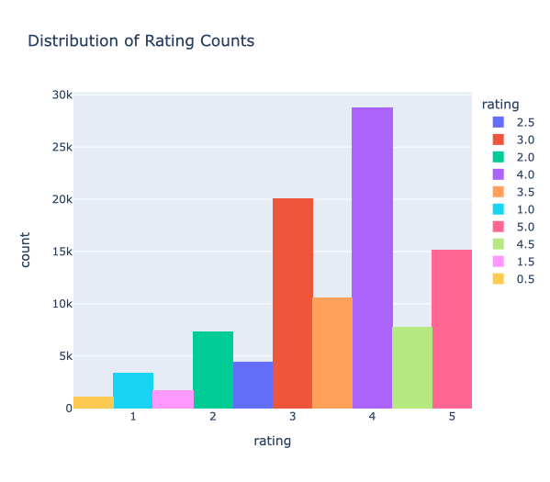
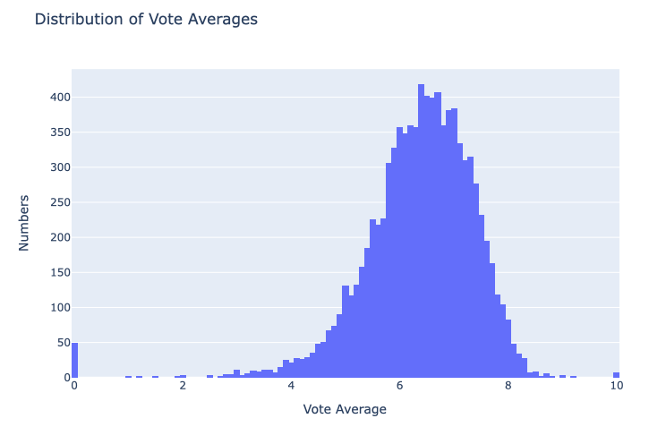
Rating EDA
The distribution of the average rating score indicates that most of the rating are between 3 to 5 and only less than 25 percent of the movie are below 3. The box plot shows the average rating is around 3.5.
The voting average distribution shows that most movies get voting score between 4 to 6
By the join the rating table with others , we can rank movies based on the rating scores or voting average
The rating and voting score are the primary features we use to feed in the user – item matrix and build the recommendation system

Slide 7
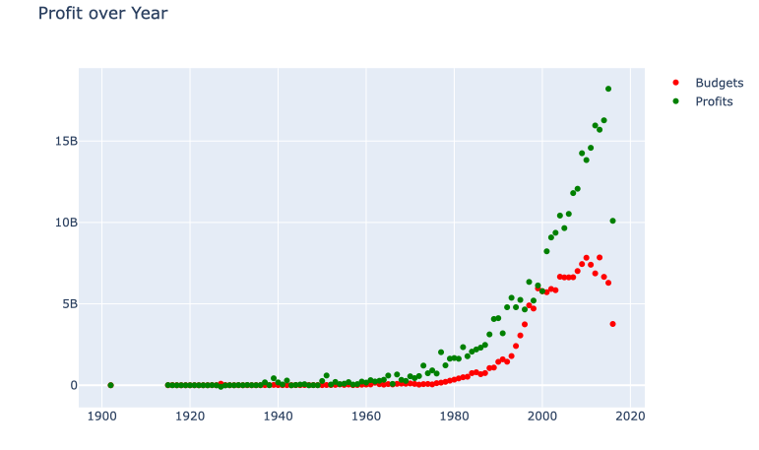
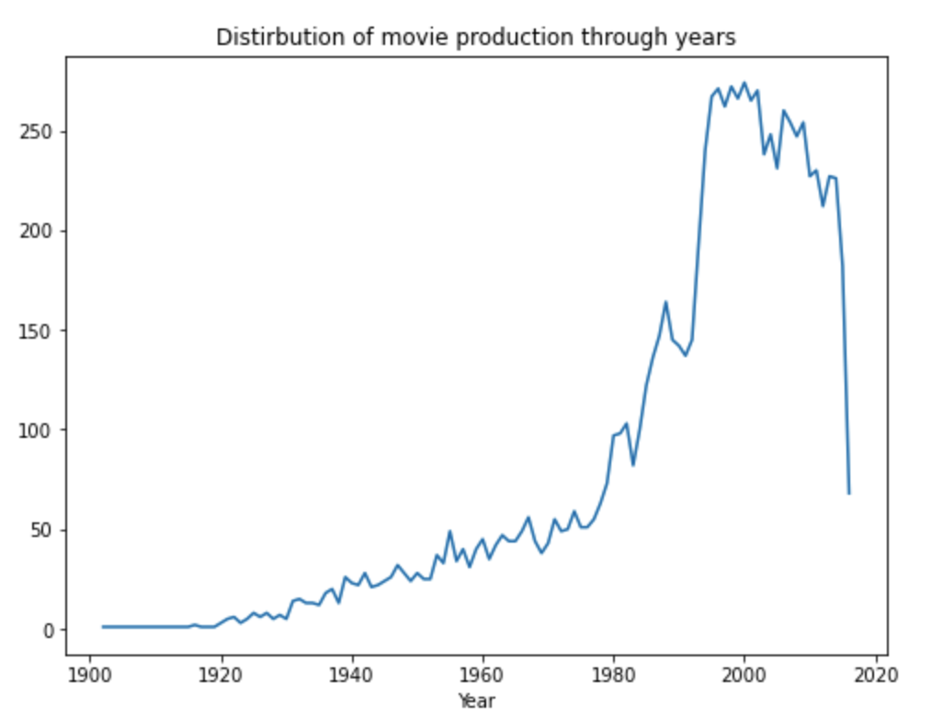
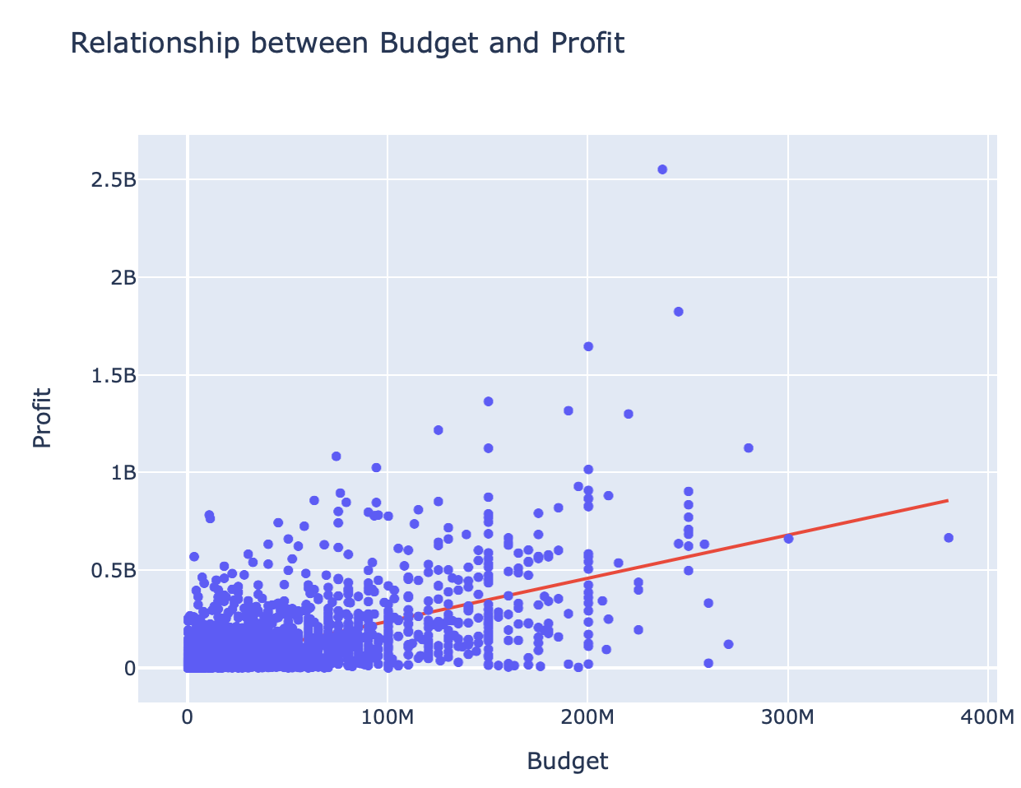
Movie EDA
We created a new feature ‘profits’ using revenue minus budget.
The production of movie jumped rapidly after 1980 and the profit increased along the way. Until 2000, the movie production started to making more profit than before, which may be affected by the new technology and more movie theatres.
The graph indicates that profit achieved highest around year 2015 and it may continue grow up to now. In addition, there is a weak linear relationship between budgets and profit.

Slide 8
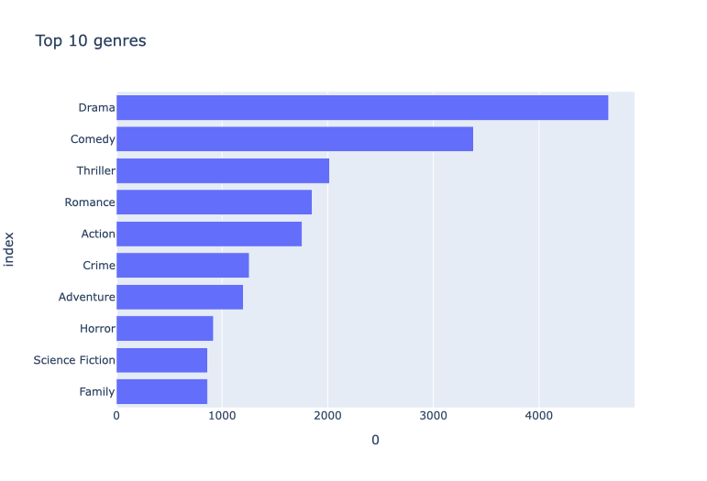
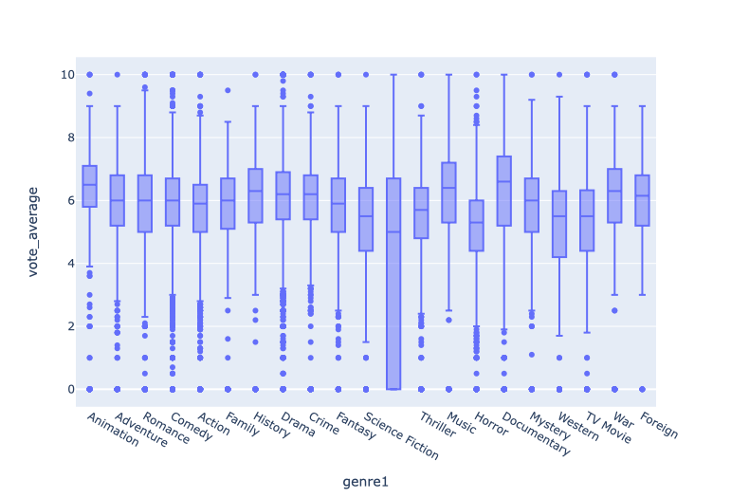
Genre EDA
It is not surprise that Drama, Comedy and Thriller are the three most popular genres.
The voting average across the top 10 genres are similar. Documentary and animation average score are sightly better than other genres.
Comedy, action and drama are more likely to receive extreme voting score than other genres

Slide 9
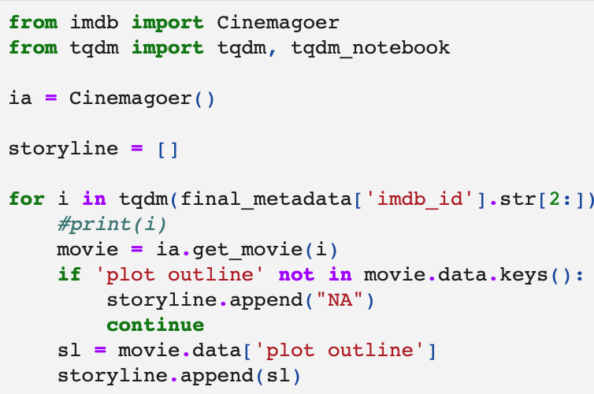
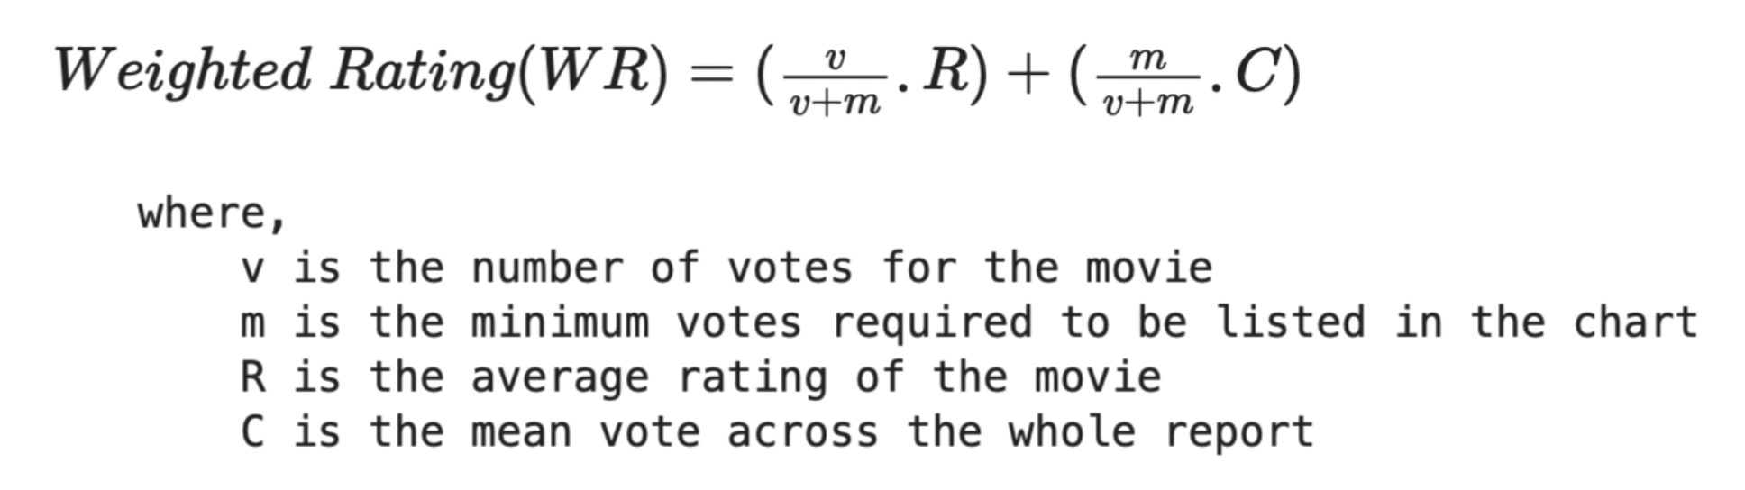
Data Preparation & Feature Engineering
IMBD library: Three additional features added
for content-based RS
Storyline: movie’s sequence of plots (Pulled through IMDB API)
Tagline: Movie’s Slogans or catchphrases
Description: Tagline + Title + Storyline
User Rating Data for Sparsity Check:
# userId 671
# movieId 9066
Rating range: 0 - 10
Sparsity: 0.984
Feature Engineering:

Slide 10





HARDWARE & SOFTWARE TOOLS USED
Anaconda
Python
PyTorch
CPU (AMD 5950X)
GPU (RTX 3080TI)
Platform to run Python & PyTorch
For Data Cleaning, EDA & Feature Engineering
For Running Deep Neural Network on GPU
To run most Cleaning, Analysis, and Modeling
To run Deep Neural Network Model

Slide 11

Models

Slide 12

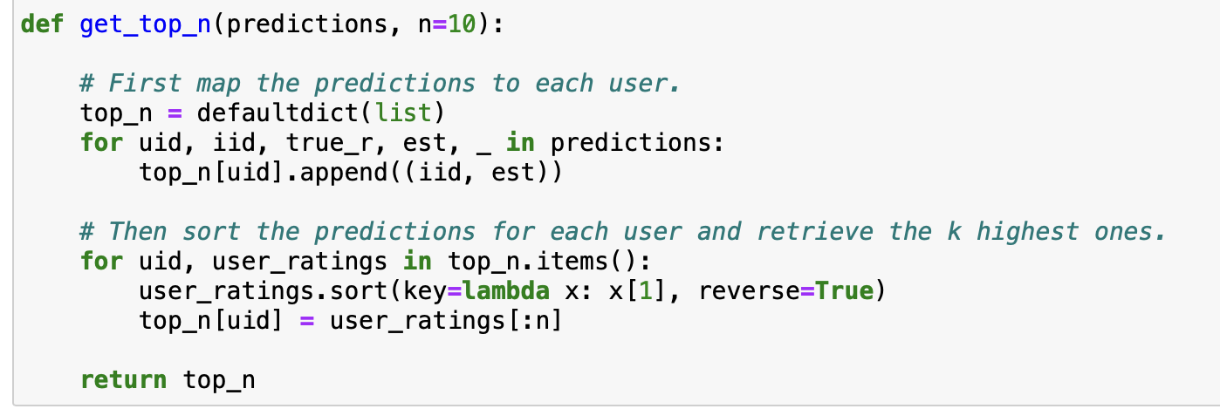
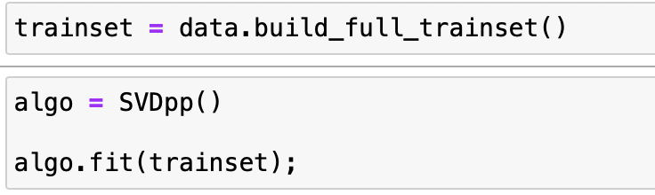
Collaborative Filtering Recommendation System
Referenced Link
Motivation:
To address the limitations of content-based recommendation such as computational cost and lack of serendipity, collaborative filtering can take into account of both implicit and explicit information from users, movies and their interactions to make recommendation.
Approach:
Model Based Collaborative filtering implemented by Singular Value Decomposition (SVD++).
SVD++ is an improved version of SVD which is a matrix factorization algorithm that can extract characteristics of the dataset’s features. SVD++ can include not only explicit ratings, but also implicit ones. Implicit feedback are collected indirectly from user interactions, and they act as a proxy for user preference
Model:
Surprise Library
Define function to get top 10 recommendations for all users

Slide 13
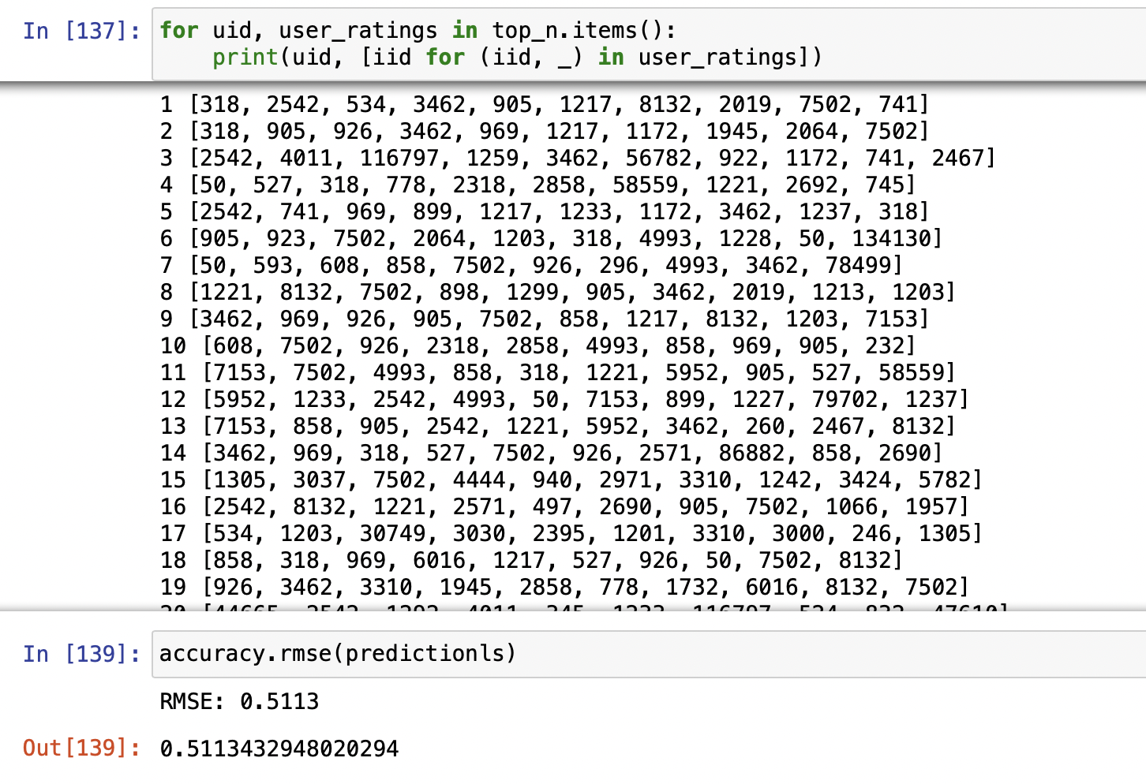
Collaborative Filtering Recommendation System
Model Result:
Top 10 recommended movies for each user
RMSE: 0.5113
Disadvantages:
Simple multiplication of latent features (inner product) may not be sufficient to capture the complex structure of user interaction data
Matrix factorization often tends to recommend popular items to everyone which does not always reflect the specific user interests
Collaborative Filtering model does not consider important side features such as movie’s content

Slide 14


NN Collaborative Filtering Recommendation System
Referenced Link
Motivation: To build a more complex collaborative filtering model by constructing user-item interaction with neural network on implicit feedback instead of explicit feedback and to present users with the highest interacted movies
Reasoning: A recommendation system that is built through implicit feedback can give recommendations real time, and doesn't need to rely on exterior user feedback data. Instead of predicting the rating that the user will give, it will now predict how likely the user will interact with the movie.
Difference between Explicit & Implicit Feedback:
Explicit Feedback
Direct & Quantitative data collected from users
Amazon rating scale of 1-10
Youtube like button for each video
Instagram like button for each advertisement they announce
Implicit Feedback
Indirect collection of interactions from users
User search history from Amazon
The length, genre, and type of Youtube video user is watching
Instagram click-through rate on each advertisement

Slide 15
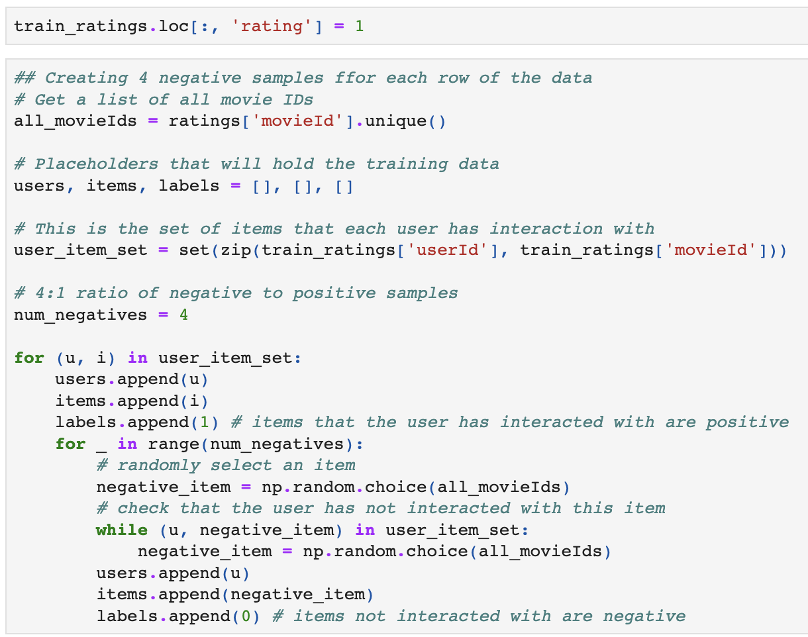
NN Collaborative Filtering Recommendation System
Feature Conversion for Modeling: Convert dataset into implicit feedback dataset --> Binarize the rating dataset
1. Converting all of the ratings into 1's as it means that they have interacted with the movie
2. Generating samples of 4 to 1 ratio of negative to positive interacting data
Reasoning: We need to create negative samples, to train the model in understanding how users don't interact to certain movies.

Slide 16
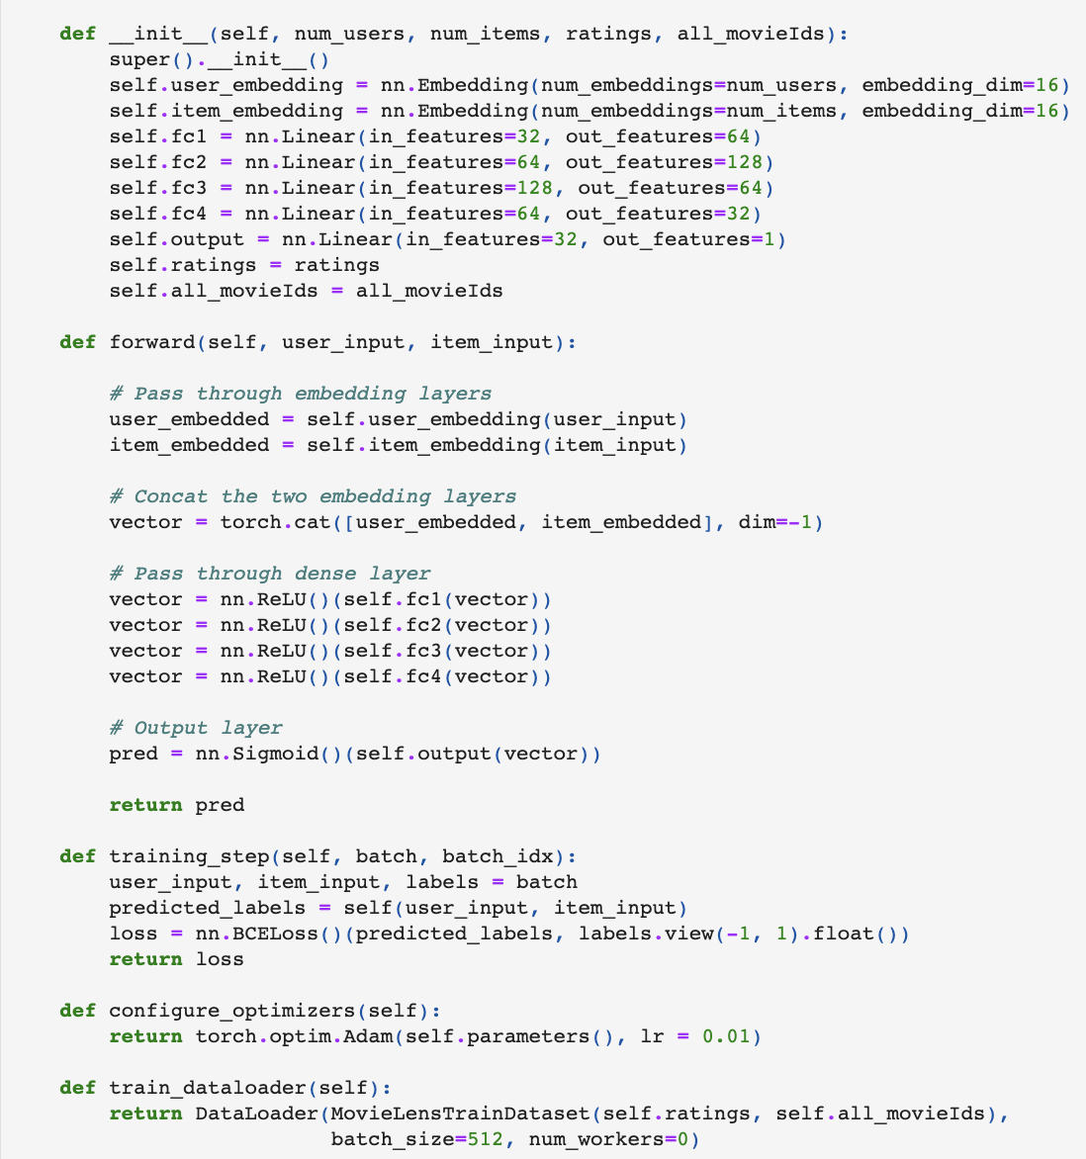
NN Collaborative Filtering Recommendation System
Model Architecture
User Embedding + Item Embedding
Concatenated Embedding
4 FC Layers
Sigmoid Output Layer
Adam Optimizer w/ 0.01 Learning Rate
50 Epochs
Trained on GPU
Ran on PyTorch & PyTorch Lightning

Slide 17
NN Collaborative Filtering Recommendation System
Evaluation: Creating the Hit Ratio @ 10
Steps & Reasoning:
1. Randomly select 99 items that the user has not selected and interacted with
2. Combine all of the 99 items with 1 of the test item (the one the user has interacted with)
3. Run the model on 100 of these items, and rank the top 10 items
4. If the test item is in the top 10 items we would call that a Hit
5. For each user that exist repeat the process, and the final number is the average hits
RMSE & Accuracy would be too simple of an evaluation for a complex model like this.

Slide 18
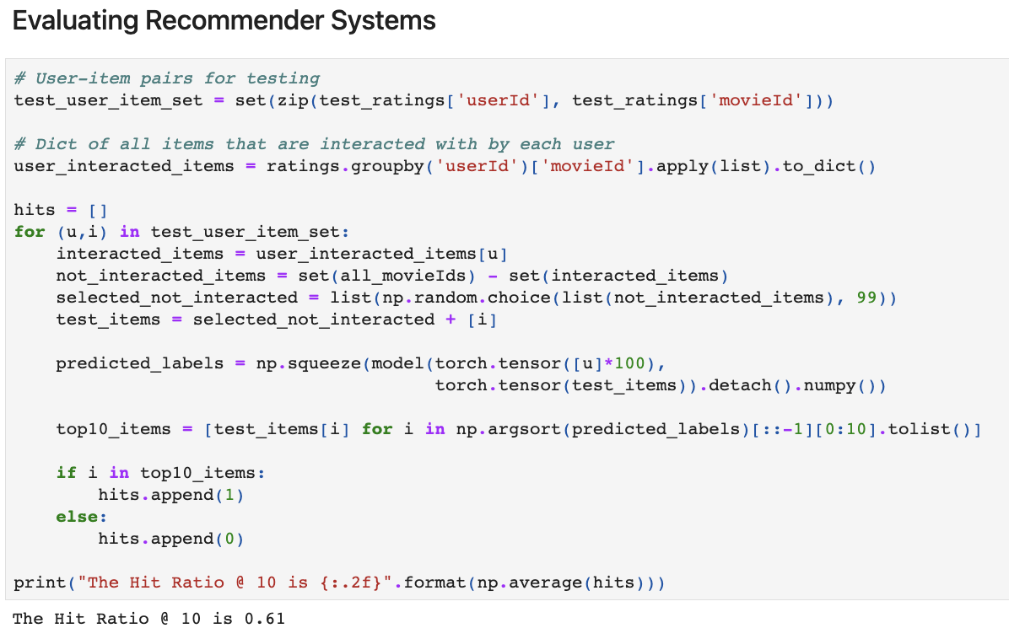
NN Collaborative Filtering Recommendation System
Model Results:
Hit Ratio @ 10: 61%
This means that 61% of the time the users were recommended items that they were actually interested in, based on the test item.
Disadvantages:
Collaborative Filtering model does not consider important side features such as movie’s content

Slide 19
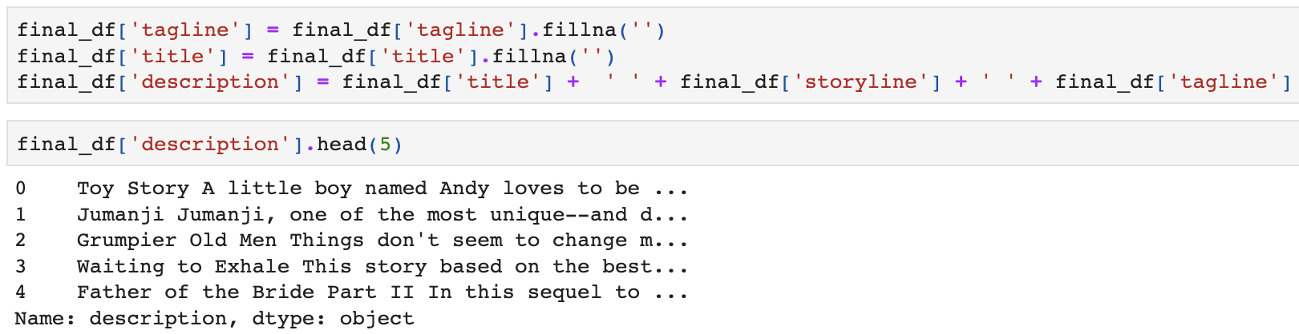
Content Based Recommendation System
Referenced Link
Motivation: Content based recommendation system can capture the words meaning and relationship of the product or service and quantify for further analysis. The data that is captured through this system can contain more information and often can provide more useful predictions compared to collaborative filtering-based recommendation.
Reasoning: Since this system is being built mainly to provide movie recommendations, movies can contain a lot of different meanings behind each storyline. Thus, by converting the storyline, tagline and the title of the movie to a quantifiable vector for recommendation, will provide a lot of additional meaning compared to just a collaborative filtering recommendation.

Slide 20
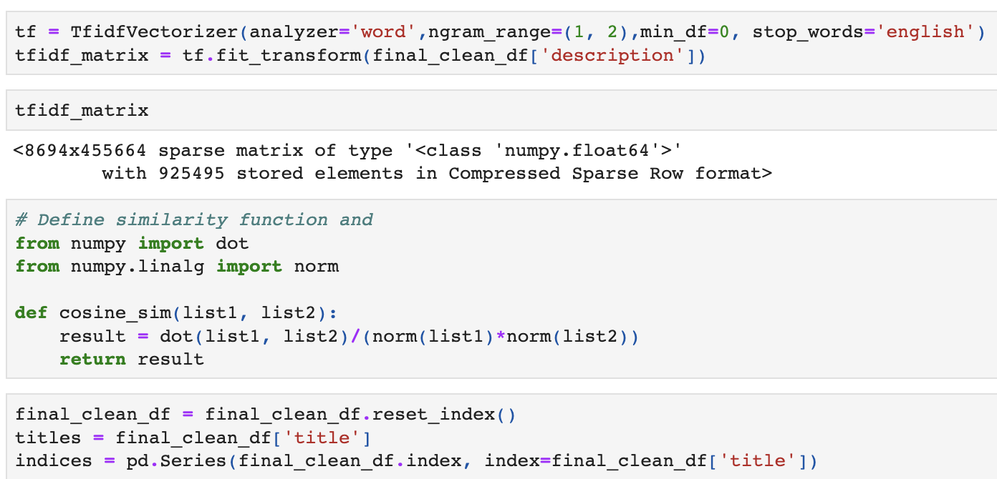
Content Based Recommendation System
Feature Conversion for Modeling:
1. Vectorize the "Description" column that combines title, tagline, & storyline using TFIDF
2. Implement a cosine similarity function, to calculate the relationship between each content, and creating a cosine similarity pairwise matrix
Reasoning:
1. By using TFIDF we are able to better understand the relationship and relevancy of each word within a movies title, tagline, and storyline.
2. Cosine similarity is able to measure the similarity between two vectors of an inner product space, it is used to measure the document similarity of the text we are analyzing

Slide 21
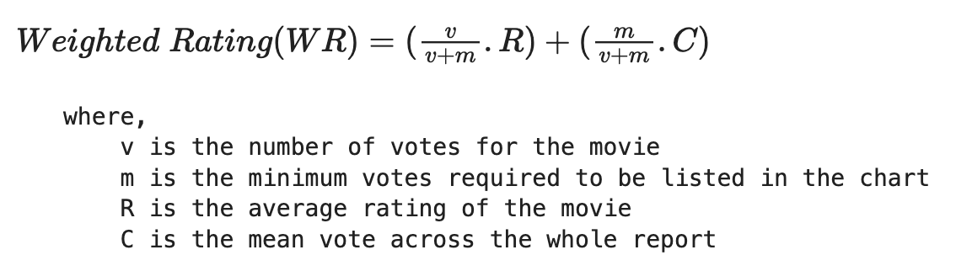
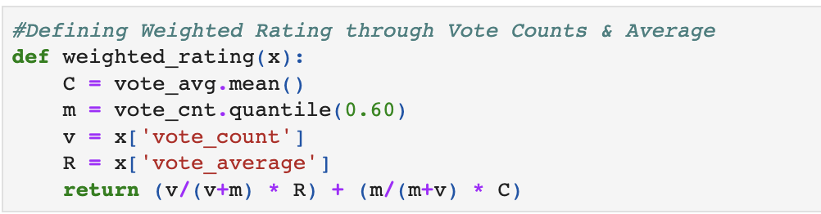
Content Based Recommendation System
Feature Creating for Modeling:
1. Creating a weighted rating column with algorithm listed on the right
Reasoning:
1. Weighted rating is required because after finding top 10 movies that are similar for recommendation. It needs to follow a certain ranking order for the user, and if it uses the normal rating scale it is biased as some ratings have 1-2 users and others have potentially 100+ users.

Slide 22
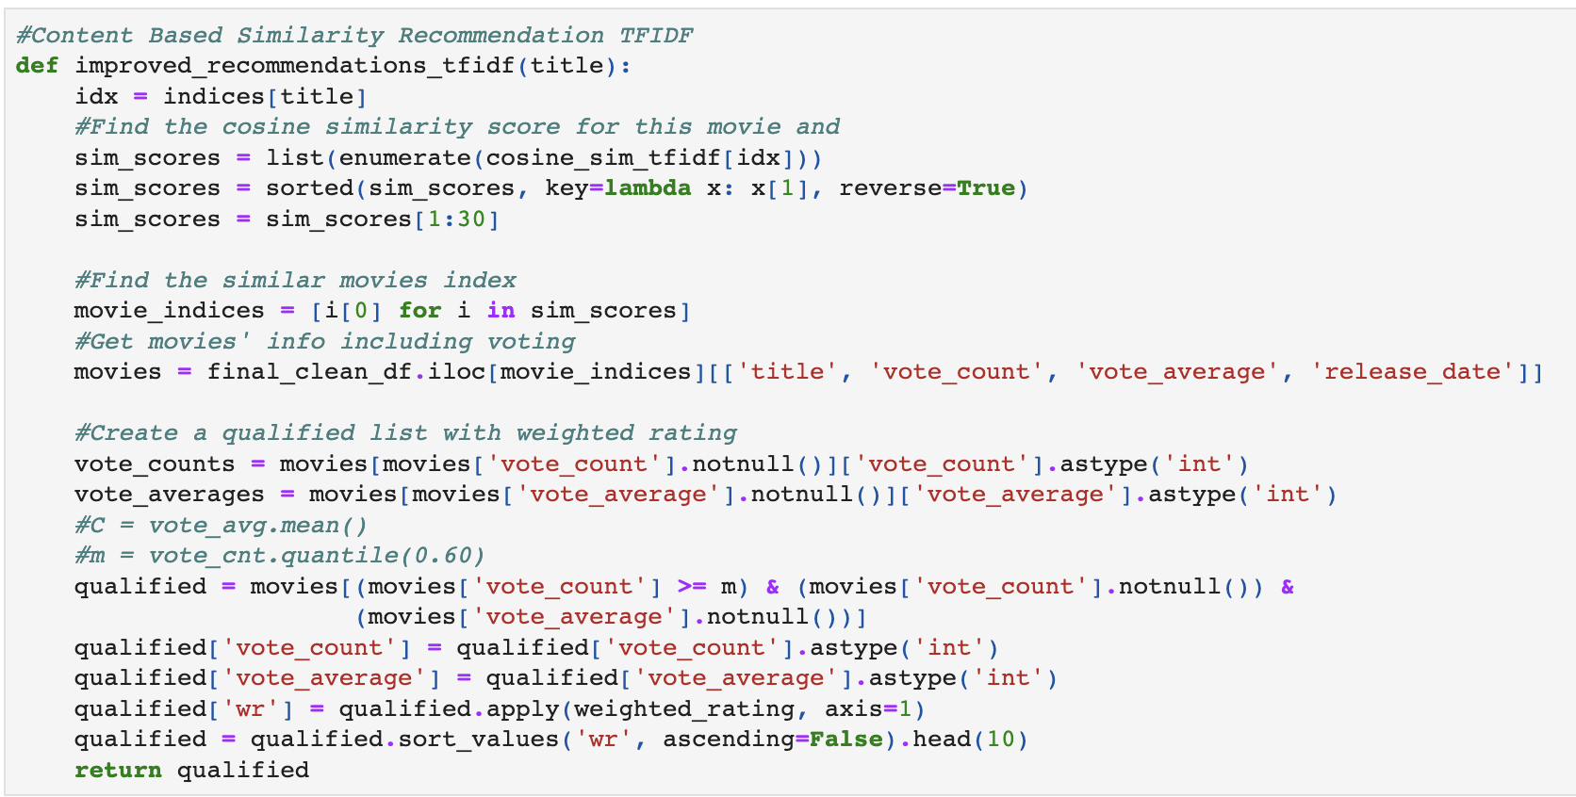
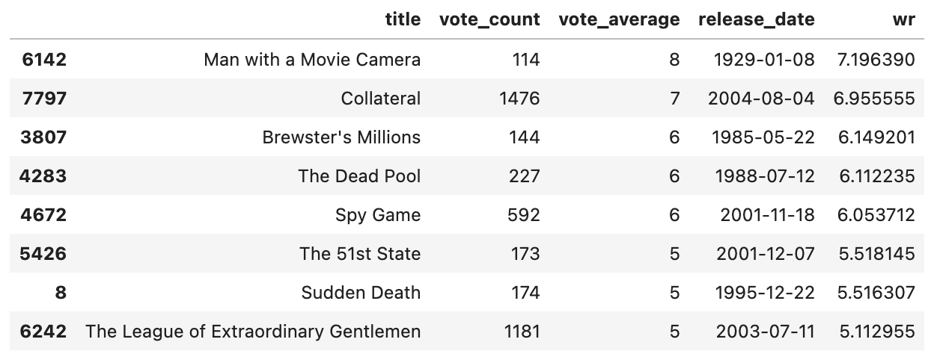
Content Based Recommendation System
Steps in Producing the Output:
1. Finding the cosine similarity score for this movie to all of the other movies
2. List out 30 of the movies that are similar based on the title, tagline, and storyline
3. Rank the top 10 movies through the weighted Rating
Model Results & Assumptions:
1. For the movie Jumanji, Man with a Movie Camera was the highest recommended movie with a weighted rating of 7.196
2. In this specific recommendation system, we assume that the users have not watched all of the recommended movies listed

Slide 23
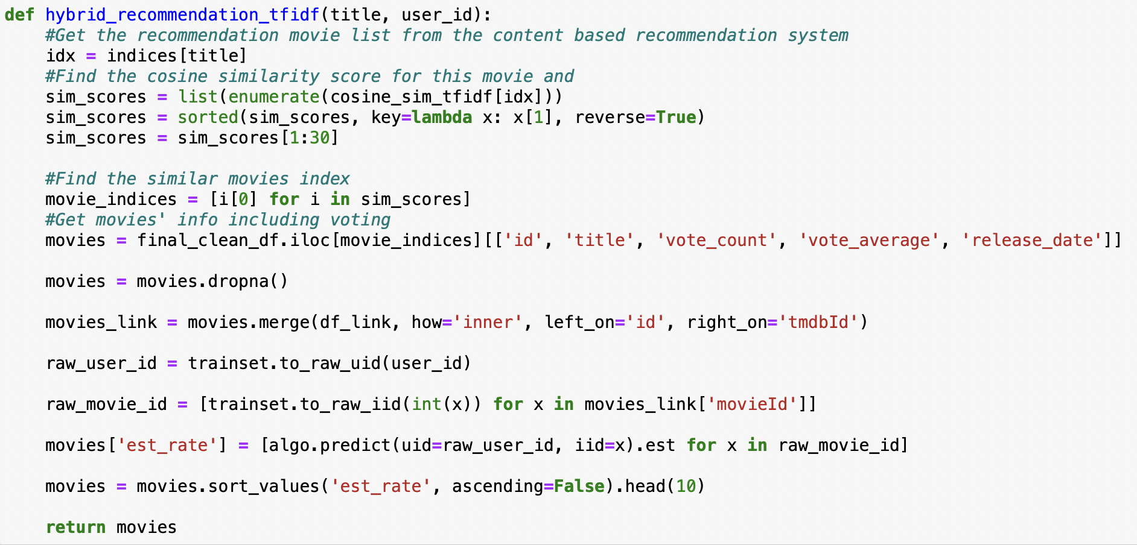
Hybrid Recommendation System
Referenced Link
Motivation:
A hybrid approach is a mixture of collaborative and content-based filtering methods while making suggestions; the film’s context also considers. The user-to-item relation and the user-to-user relation also play a vital role at the time of the recommendation. This framework gives film recommendations as per the user’s knowledge, provides unique recommendations, and solves a problem if the specific buyer ignores relevant data.
Approach:
Combine Content Based recommendation and Collaborative Filtering recommendation
Model:

Slide 24
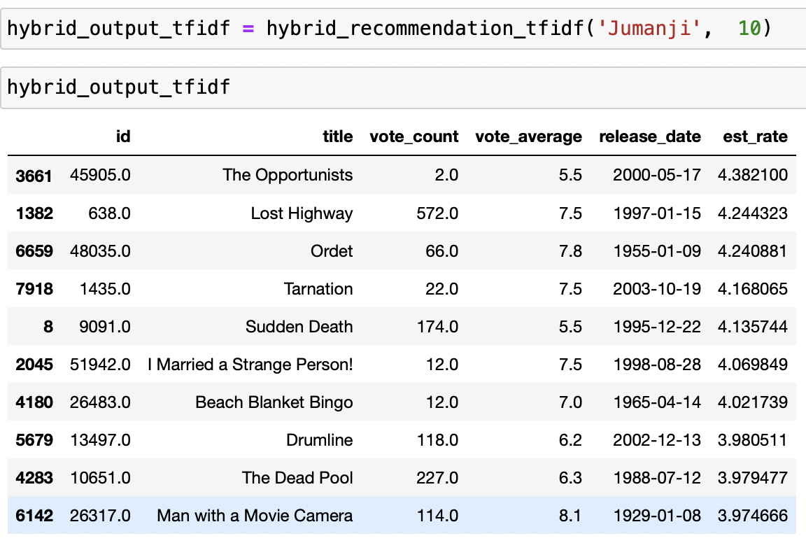
Hybrid Recommendation System
Model Results:
est_rate: estimated rating from Collaborative Filtering model
Top 10 recommendation with most similar movies content-wise and highest estimated rating for userid 10 based on watched movie Jumanji

Slide 25
Evaluation
Evaluation by statistical metrics:
1. RMSE of predicted ratings --> Collaborative Filtering
2. Hit 10 Ratio
Evaluation by observation:
By looking at the recommendation generated by our models, we can check if the recommended movies make sense or not
Evaluation in real business context:
Measure the user engagement with metrics such as:
Like : Unlike Ratio in our Recommendation
Ratio of movie watched through Recommendation : Ratio of movie watched through Search

Slide 26
Findings & Conclusion
Based on our exploration over content-based model, collaborative filtering, neural network collaborative filtering and finally, hybrid model, we found that hybrid model gave us the most relevant recommendations based on the evaluation metrics and our observation. However, the model needs to be piloted and tested in the real-world business context. We have set up several key metrics to monitor our model’s performance and we will keep tuning our model based on them.

Slide 27
Lessons Learnt & Future Recommendation
Lessons Learnt:
The difference between implicit and explicit feedback
The installation process of PyTorch and how to initiate GPU training on certain models and NLP process's
The implementation of neural networks in creating a more complex collaborative filtering recommendation model and the final outputs of learning rate, activations, fc and output layers
The usage of NLP tools like TFIDF, Count Vectorizer, and GloVe in content based recommendation systems
The benefits of a hybrid recommendation system, that combines collaborative filtering and content based analysis
Recommendation:
To try using the SVM model in creating a recommendation system
Within the content based recommendation system, implement a function that detects if the user has watched the movie or not, and only recommend movies that the user haven't watched yet
Hyper parameter tuning on additional layers and activation functions of the neural network collaborative filtering model

Slide 28
Thanks!
Any questions?

Slide 29
References
All links are attached below the model title, the link to our data is listed as the link below:
https://www.kaggle.com/datasets/rajmehra03/movielens100k
Link to IMDB API Documentation:
https://buildmedia.readthedocs.org/media/pdf/imdbpy/latest/imdbpy.pdf
Link to TMDB API Documentation:
https://developers.themoviedb.org/3/getting-started/introduction

